Slide 1
The Threat Environment
Corporate Computer Security, 4th Edition
Randall J. Boyle & Raymond R. Panko
Chapter 1

Slide 2
Learning Objectives
Define the term threat environment.
Use basic security terminology.
Describe threats from employees and ex-employees.
Describe threats from malware writers.
Describe traditional external hackers and their attacks, including break-in processes, social engineering, and denial-of-service attacks.
Know that criminals have become the dominant attackers today, describe the types of attacks they make, and discuss their methods of cooperation.
Distinguish between cyberwar and cyberterror.

Slide 3
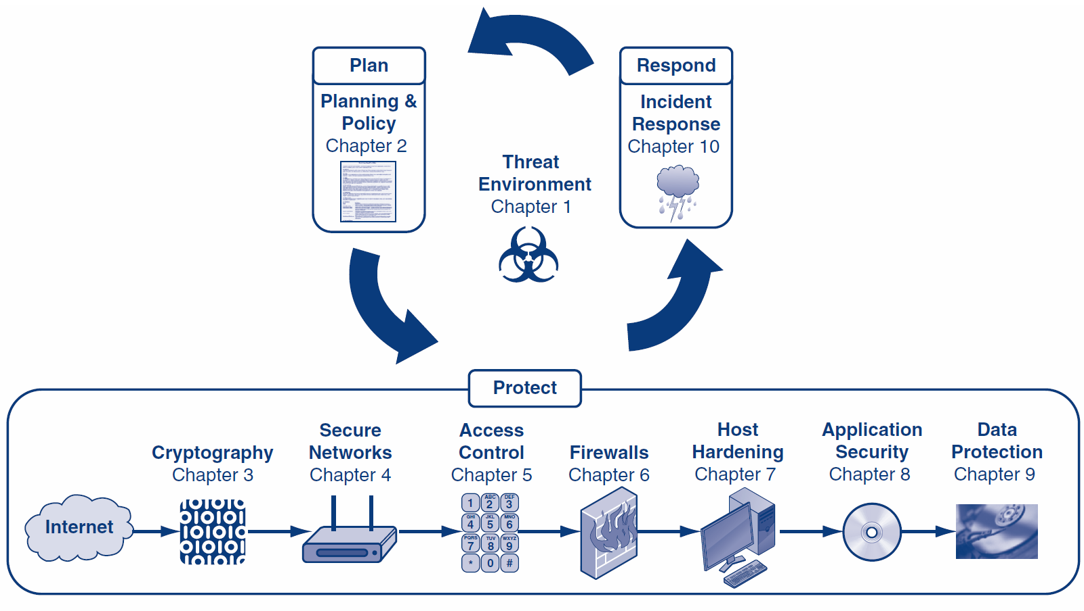
How is this book organized?

Slide 4
Orientation
This is a book about security defense, not how to attack
Defense is too complex to focus the book mostly on specific attacks
However, this first chapter looks at the threat environment—attackers and their attacks
Unless you understand the threats you face, you cannot prepare for defense
All subsequent chapters focus on defense

Slide 5
What’s Next?
1.1 Introduction & Terminology
1.2 Employee and Ex-Employee Threats
1.3 Malware
1.4 Hackers and Attacks
1.5 The Criminal Era
1.6 Competitor Threats
1.7 Cyberwar and Cyberterror

Slide 6
1.1: Basic Security Terminology
The Threat Environment
The threat environment consists of the types of attackers and attacks that companies face

Slide 7
1.1: Basic Security Terminology
Security Goals
Confidentiality
Confidentiality means that people cannot read sensitive information, either while it is on a computer or while it is traveling across a network.

Slide 8
1.1: Basic Security Terminology
Security Goals
Integrity
Integrity means that attackers cannot change or destroy information, either while it is on a computer or while it is traveling across a network. Or, at least, if information is changed or destroyed, then the receiver can detect the change or restore destroyed data.

Slide 9
1.1: Basic Security Terminology
Security Goals
Availability
Availability means that people who are authorized to use information are not prevented from doing so

Slide 10
1.1: Basic Security Terminology
Compromises
Successful attacks
Also called incidents
Also called breaches (not breeches)

Slide 11
1.1: Basic Security Terminology
Countermeasures
Tools used to thwart attacks
Also called safeguards, protections, and controls
Types of countermeasures
Preventative
Detective
Corrective

Slide 12
1.1: The Sony Data Breaches
Sony Corporation
Japanese multinational corporation founded in 1946 that focuses on electronics, games, entertainment, and financial services
Employs about 146,300 people and has annual revenues of about $72.3 billion
Sony is widely known for its televisions, digital imaging, audio/video hardware, PCs, semiconductors, electronic components, and gaming platform.

Slide 13
1.1: The Sony Data Breaches
The First Attack
April 17-19, 2011
Attacks happened a few weeks after the large earthquake, tsunami, and reactor meltdowns
Used SQL injection to steal 77 million accounts
Turned off access to PlayStation Network (PSN)
Publicly acknowledges intrusion a week after the intrusion, on April 26th
CEO, Kazuo Hirai, issues public apology
Hacking group “Anonymous” is suspected

Slide 14
1.1: The Sony Data Breaches
The Second Attack
May 1st, 2011 – Sony Online Entertainment
Similar SQL injection attack used to steal additional 24.6 million accounts
Turned off access to all Sony Online Entertainment servers
CEO, Kazuo Hirai, issues written response to US Congress (May 4th) about steps to prevent future attacks
Some PSN services start to come online on May 15th

Slide 15
1.1: The Sony Data Breaches
The Third Attack
June 2nd, 2011 – SonyPictures.com
Similar SQL injection attack used to steal additional 1 million accounts
SonyPictures.com is immediately shut down
Hacking group LulzSec claims responsibility and issues press statement

Slide 16
1.1: The Sony Data Breaches
LulzSec press statement
“Greetings folks. We're LulzSec, and welcome to Sownage. Enclosed you will find various collections of data stolen from internal Sony networks and websites, all of which we accessed easily and without the need for outside support or money.
We recently broke into SonyPictures.com and compromised over 1,000,000 users' personal information, including passwords, email addresses, home addresses, dates of birth, and all Sony opt-in data associated with their accounts. Among other things, we also compromised all admin details of Sony Pictures (including passwords) along with 75,000 ‘music codes’ and 3.5 million ‘music coupons’.”

Slide 17
1.1: The Sony Data Breaches
SQL injection is an attack that involves sending modified SQL statements to a web application that will, in turn, modify a database.
Attackers can send unexpected input through their web browser which will enable them to read from, write to, and even delete entire databases.

Slide 18
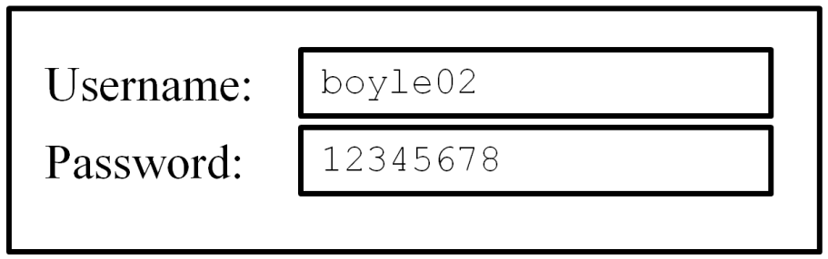
1.1: The Sony Data Breaches
SQL statement below shows parameters passed to a database for a legitimate login
SELECT FROM Users WHERE username=‘boyle02’ AND password=‘12345678’;

Slide 19
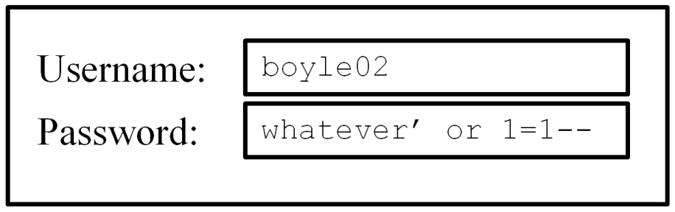
1.1: The Sony Data Breaches
Malformed SQL statement below shows SQL injection by passing unexpected parameters through a Web interface
Will always return a true value
SELECT FROM Users WHERE username=‘boyle02’ AND password=‘whatever’ or 1=1--’;

Slide 20
1.1: The Sony Data Breaches
The attackers
Members of both LulzSec and Anonymous are involved
Just before attacks on Sony, Anonymous announced the launch of operation “#OpSony” for lawsuits against George Hotz
George Hotz was being sued by Sony for jailbreaking PlayStation 3
Cody Kretsinger was arrested on Sept. 22, 2011 and pled guilty for his involvement in the Sony attacks
Hector Monsegur, facing 122 years in prison, was key informant who identified other attackers

Slide 21
1.1: The Sony Data Breaches
The Fall-Out: Lawsuits and Investigations
Sony offered 1 year of free identify theft services, month of free gaming, and a few free games from a limited selection
To date, no known credit fraud directly tied to the Sony data breaches
Fined $395,000 by UK because “security measures were simply not good enough”
Sony estimates losses at $171 million
Difficult to estimate damage to Sony’s reputation

Slide 22
What’s Next?
1.1 Introduction & Terminology
1.2 Employee and Ex-Employee Threats
1.3 Malware
1.4 Hackers and Attacks
1.5 The Criminal Era
1.6 Competitor Threats
1.7 Cyberwar and Cyberterror

Slide 23
1.2: Employee and Ex-Employee Threats
Employees and Ex-Employees Are Dangerous
Dangerous because
They have knowledge of internal systems
They often have the permissions to access systems
They often know how to avoid detection
Employees generally are trusted
IT and especially IT security professionals are the greatest employee threats (Qui custodiet custodes?)

Slide 24
1.2: Employee and Ex-Employee Threats
Employee Sabotage
Destruction of hardware, software, or data
Plant time bomb or logic bomb on computer
Employee Hacking
Hacking is intentionally accessing a computer resource without authorization or in excess of authorization
Authorization is the key

Slide 25
1.2: Employee and Ex-Employee Threats
Employee Financial Theft
Misappropriation of assets
Theft of money
Employee Theft of Intellectual Property (IP)
Copyrights and patents (formally protected)
Trade secrets: plans, product formulations, business processes, and other info that a company wishes to keep secret from competitors

Slide 26
1.2: Employee and Ex-Employee Threats
Employee Extortion
Perpetrator tries to obtain money or other goods by threatening to take actions that would be against the victim’s interest
Sexual or Racial Harassment of Other Employees
Via e-mail
Displaying pornographic material

Slide 27
1.2: Employee and Ex-Employee Threats
Internet Abuse
Downloading pornography, which can lead to sexual harassment lawsuits and viruses
Downloading pirated software, music, and video, which can lead to copyright violation penalties
Excessive personal use of the Internet at work

Slide 28
1.2: Employee and Ex-Employee Threats
Carelessness
Loss or theft of computers or data media containing sensitive information
Other “Internal” Attackers
Contract workers
Workers in contracting companies

Slide 29
What’s Next?
1.1 Introduction & Terminology
1.2 Employee and Ex-Employee Threats
1.3 Malware
1.4 Hackers and Attacks
1.5 The Criminal Era
1.6 Competitor Threats
1.7 Cyberwar and Cyberterror

Slide 30
1.3: Classic Malware: Viruses and Worms
Malware
A generic name for any “evil software”
Viruses
Programs that attach themselves to legitimate programs on the victim’s machine
Spread today primarily by e-mail
Also by instant messaging, file transfers, etc.

Slide 31
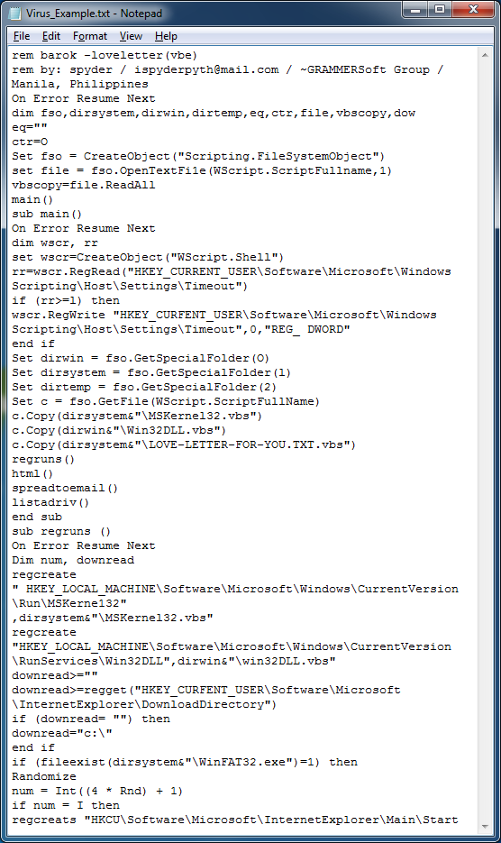
1.3: Classic Malware: Viruses and Worms
ILOVEYOU virus source code:

Slide 32
1.3: Classic Malware: Viruses and Worms
Worms
Full programs that do not attach themselves to other programs
Like viruses, can spread by e-mail, instant messaging, and file transfers

Slide 33
1.3: Classic Malware: Viruses and Worms
Worms
In addition, direct-propagation worms can jump from one computer to another without human intervention on the receiving computer
Computer must have a vulnerability for direct propagation to work
Direct-propagation worms can spread extremely rapidly because they do not have to wait for users to act

Slide 34
1.3: Classic Malware: Viruses and Worms
Blended Threats
Malware propagates in several ways—like worms, viruses, compromised webpages containing mobile code, etc.
Payloads
Pieces of code that do damage
Implemented by viruses and worms after propagation
Malicious payloads are designed to do heavy damage

Slide 35
1.3: Trojan Horses and Rootkits
Nonmobile Malware
Must be placed on the user’s computer through one of a growing number of attack techniques
Placed on computer by hackers
Placed on computer by virus or worm as part of its payload
The victim can be enticed to download the program from a website or FTP site
Mobile code executed on a webpage can download the nonmobile malware

Slide 36
1.3: Trojan Horses and Rootkits
Trojan Horses
A program that replaces an existing system file, taking its name
Trojan Horses
Remote Access Trojans (RATs)
Remotely control the victim’s PC
Downloaders
Small Trojan horses that download larger Trojan horses after the downloader is installed

Slide 37
1.3: Trojan Horses and Rootkits
Trojan Horses
Spyware
Programs that gather information about you and make it available to the adversary
Cookies that store too much sensitive personal information
Keystroke loggers
Password-stealing spyware
Data mining spyware

Slide 38
1.3: Trojan Horses and Rootkits
Trojan Horses
Rootkits
Take control of the super user account (root, administrator, etc.)
Can hide themselves from file system detection
Can hide malware from detection
Extremely difficult to detect (ordinary antivirus programs find few rootkits)

Slide 39
1.3: Other Malware Attacks
Mobile Code
Executable code on a webpage
Code is executed automatically when the webpage is downloaded
Javascript, Microsoft Active-X controls, etc.
Can do damage if computer has vulnerability

Slide 40
1.3: Other Malware Attacks
Social Engineering in Malware
Social engineering is attempting to trick users into doing something that goes against security policies
Several types of malware use social engineering
Spam
Phishing
Spear phishing (aimed at individuals or specific groups)
Hoaxes

Slide 41
What’s Next?
1.1 Introduction & Terminology
1.2 Employee and Ex-Employee Threats
1.3 Malware
1.4 Hackers and Attacks
1.5 The Criminal Era
1.6 Competitor Threats
1.7 Cyberwar and Cyberterror

Slide 42
1.4: Traditional External Attackers: Hackers
Traditional Hackers
Motivated by thrill, validation of skills, sense of power
Motivated to increase reputation among other hackers
Often do damage as a byproduct
Often engage in petty crime

Slide 43
1.4: Traditional External Attackers: Hackers
Anatomy of a Hack
Reconnaissance probes (Figure 1-11)
IP address scans to identify possible victims
Port scans to learn which services are open on each potential victim host

Slide 44
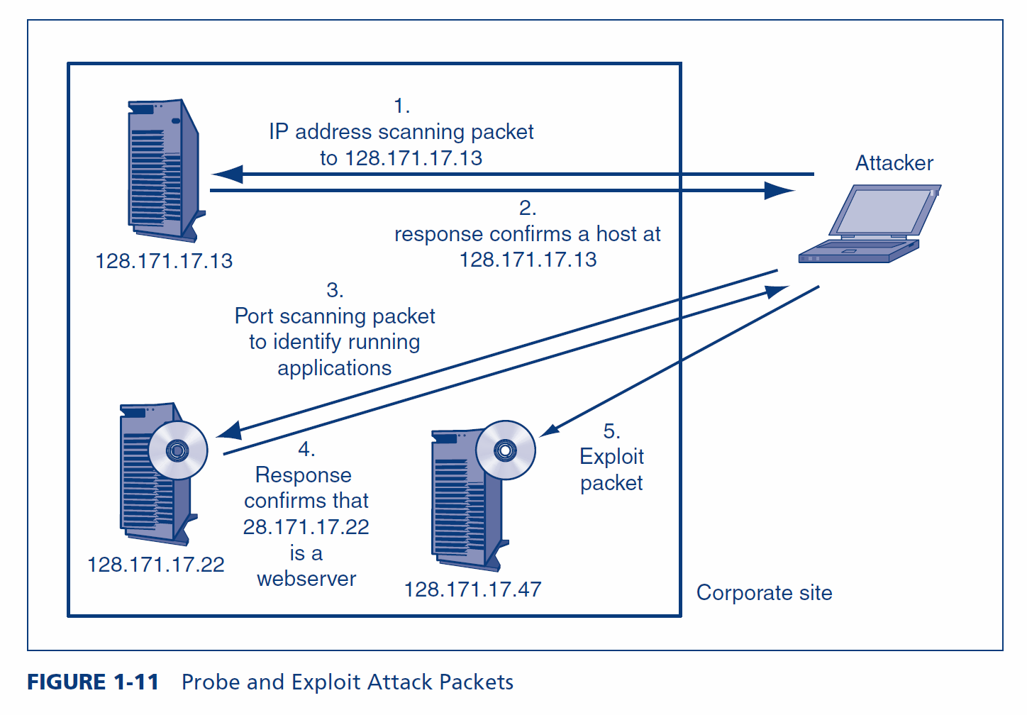
1.4: Probe and Exploit Attack Packets

Slide 45
1.4: Traditional External Attackers: Hackers
Anatomy of a Hack
The exploit
The specific attack method that the attacker uses to break into the computer is called the attacker’s exploit
The act of implementing the exploit is called exploiting the host

Slide 46
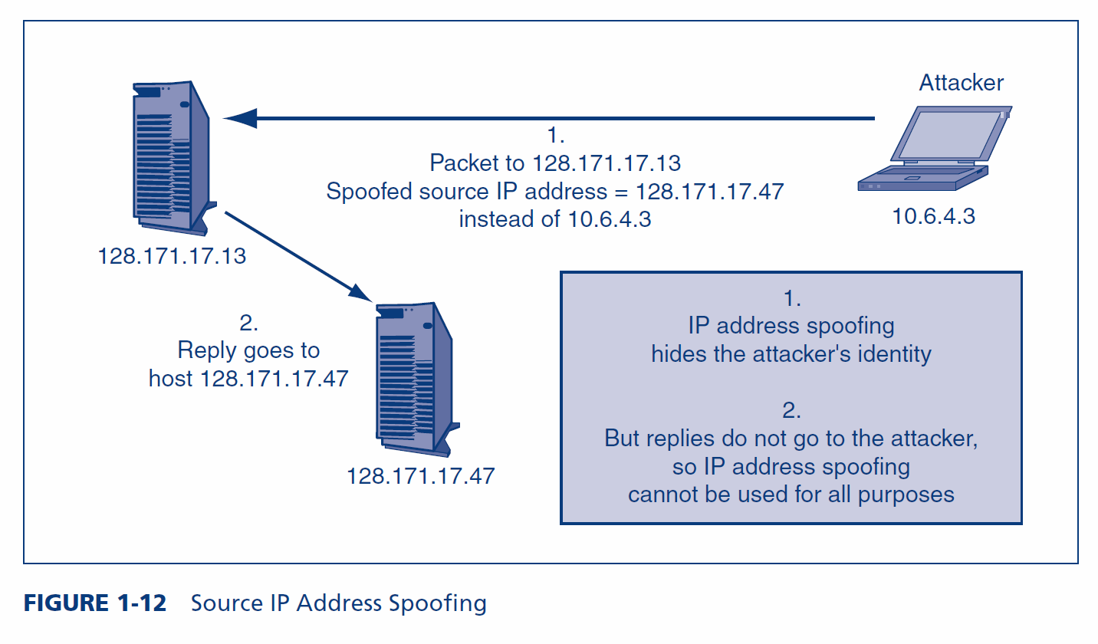
1.4: Source IP Address Spoofing

Slide 47
1.4: Traditional External Attackers: Hackers
Chain of attack computers (Figure 1-13)
The attacker attacks through a chain of victim computers
Probe and exploit packets contain the source IP address of the last computer in the chain
The final attack computer receives replies and passes them back to the attacker
Often, the victim can trace the attack back to the final attack computer
But the attack can usually only be traced back a few computers more

Slide 48
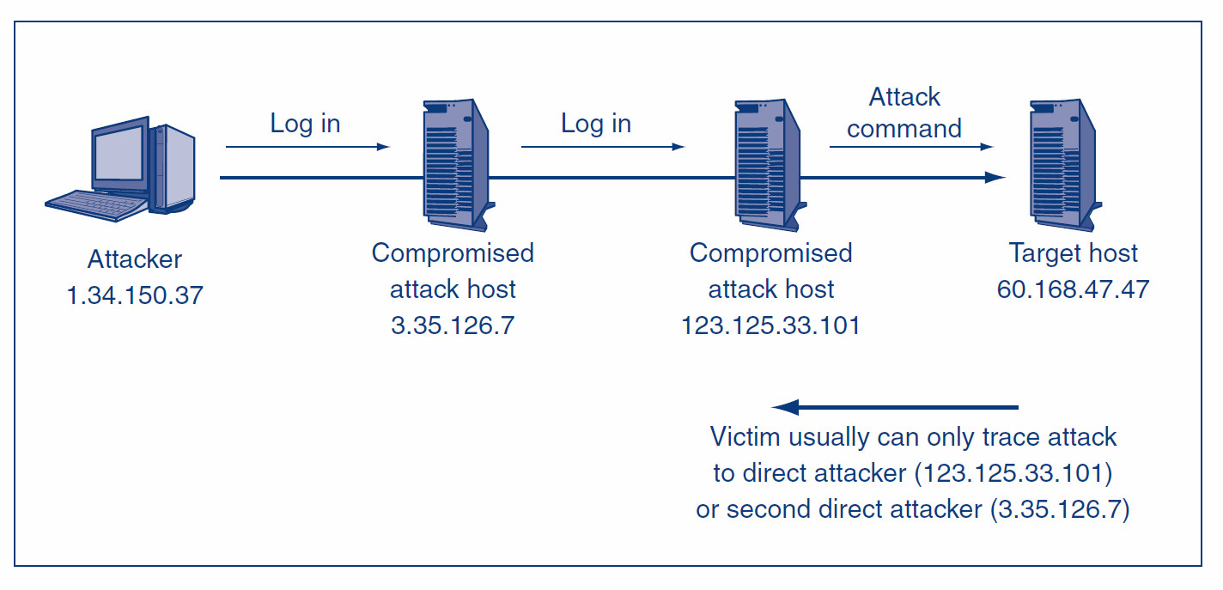
1.4: Chain of Attack Computers
For probes whose replies must
be received, attacker sends
probes through a chain of
attack computers.
Victim only knows the identity
of the last compromised host
(123.125.33.101), not that of the attacker.

Slide 49
1.4: Traditional External Attackers: Hackers
Social Engineering
Social engineering is often used in hacking
Call and ask for passwords and other confidential information
E-mail attack messages with attractive subjects
Piggybacking
Shoulder surfing
Pretexting
Etc.
Often successful because it focuses on human weaknesses instead of technological weaknesses

Slide 50
1.4: Traditional External Attackers: Hackers
Denial-of-Service (DoS) Attacks
Make a server or entire network unavailable to legitimate users
Typically send a flood of attack messages to the victim
Distributed DoS (DDoS) Attacks (Figure 1-15)
Bots flood the victim with attack packets
Attacker controls the bots

Slide 51
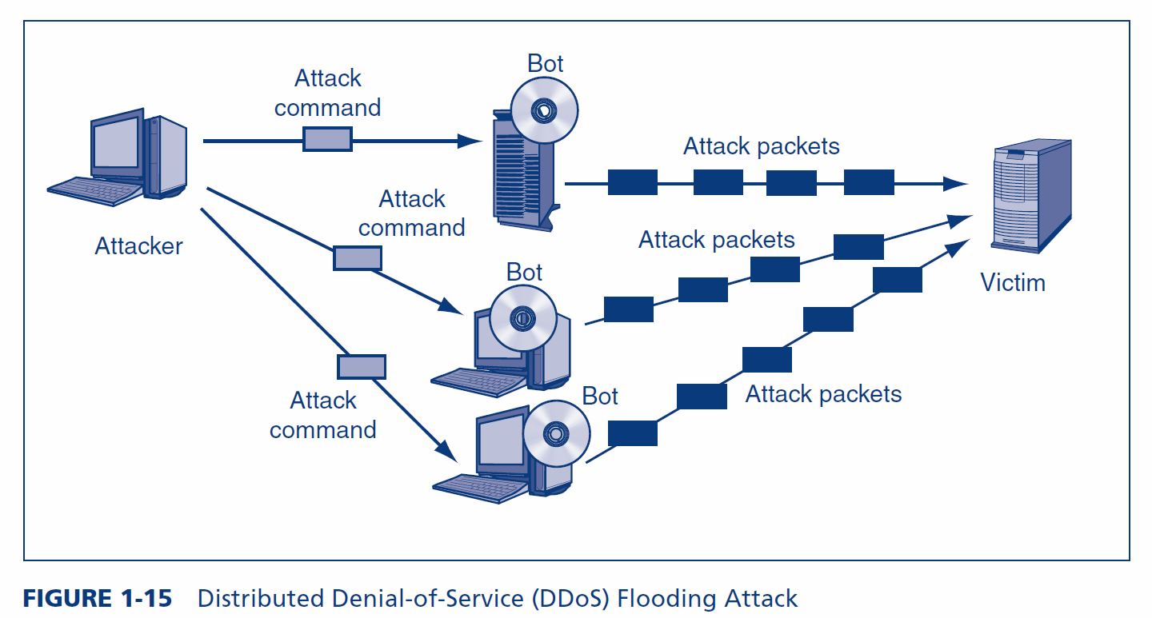
1.4: Distributed Denial-of-Service (DDoS) Flooding Attack

Slide 52
1.4: Traditional External Attackers: Hackers
Skill Levels
Expert attackers are characterized by strong technical skills and dogged persistence
Expert attackers create hacker scripts to automate some of their work
Scripts are also available for writing viruses and other malicious software

Slide 53
1.4: Traditional External Attackers: Hackers
Skill Levels
Script kiddies use these scripts to make attacks
Script kiddies have low technical skills
Script kiddies are dangerous because of their large numbers

Slide 54
What’s Next?
1.1 Introduction & Terminology
1.2 Employee and Ex-Employee Threats
1.3 Malware
1.4 Hackers and Attacks
1.5 The Criminal Era
1.6 Competitor Threats
1.7 Cyberwar and Cyberterror

Slide 55
1.5: The Criminal Era
The Criminal Era
Today, most attackers are career criminals with traditional criminal motives
Adapt traditional criminal attack strategies to IT attacks (e.g., fraud, etc.)

Slide 56
1.5: The Criminal Era
The Criminal Era
Many cybercrime gangs are international
Makes prosecution difficult
Dupe citizens of a country into being transshippers of fraudulently purchased goods to the attacker in another country
Cybercriminals use black market forums
Credit card numbers and identity information
Vulnerabilities
Exploit software (often with update contracts)

Slide 57
1.5: The Criminal Era
Fraud
In fraud, the attacker deceives the victim into doing something against the victim’s financial self-interest
Criminals are learning to conduct traditional frauds and new frauds over networks
Also, new types of fraud, such as click fraud

Slide 58
1.5: The Criminal Era
Financial and Intellectual Property Theft
Steal money or intellectual property that can be sold to other criminals or to competitors
Extortion
Threaten a DoS attack or threaten to release stolen information unless the victim pays the attacker

Slide 59
1.5: The Criminal Era
Stealing Sensitive Data about Customers and Employees
Carding (credit card number theft)
Bank account theft
Online stock account theft
Identity theft
Steal enough identity information to represent the victim in large transactions, such as buying a car or even a house

Slide 60
1.5: The Criminal Era
Corporate Identity Theft
Steal the identity of an entire corporation
Accept credit cards on behalf of the corporation
Pretend to be the corporation in large transactions
Can even take ownership of the corporation

Slide 61
What’s Next?
1.1 Introduction & Terminology
1.2 Employee and Ex-Employee Threats
1.3 Malware
1.4 Hackers and Attacks
1.5 The Criminal Era
1.6 Competitor Threats
1.7 Cyberwar and Cyberterror

Slide 62
1.6: Competitor Threats
Commercial Espionage
Attacks on confidentiality
Public information gathering
Company website and public documents
Facebook pages of employees, etc.
Trade secret espionage
May only be litigated if a company has provided reasonable protection for those secrets
Reasonableness reflects the sensitivity of the secret and industry security practices

Slide 63
1.6: Competitor Threats
Commercial Espionage
Trade secret theft approaches
Theft through interception, hacking, and other traditional cybercrimes
Bribe an employee
Hire your ex-employee and solicite or accept trade secrets
National intelligence agencies engage in commercial espionage

Slide 64
1.6: Competitor Threats
Denial-of-Service Attacks by Competitors
Attacks on availability
Rare, but can be devastating

Slide 65
What’s Next?
1.1 Introduction & Terminology
1.2 Employee and Ex-Employee Threats
1.3 Malware
1.4 Hackers and Attacks
1.5 The Criminal Era
1.6 Competitor Threats
1.7 Cyberwar and Cyberterror

Slide 66
1.7: Cyberwar and Cyberterror
Cyberwar and Cyberterror
Attacks by national governments (cyberwar)
Attacks by organized terrorists (cyberterror)
Nightmare threats
Potential for far greater attacks than those caused by criminal attackers

Slide 67
1.7: Cyberwar and Cyberterror
Cyberwar
Computer-based attacks by national governments
Espionage
Cyber-only attacks to damage financial and communication infrastructure
To augment conventional physical attacks
Attack IT infrastructure along with physical attacks (or in place of physical attacks)
Paralyze enemy command and control
Engage in propaganda attacks

Slide 68
1.7: Cyberwar and Cyberterror
Cyberterror
Attacks by terrorists or terrorist groups
May attack IT resources directly
Use the Internet for recruitment and coordination
Use the Internet to augment physical attacks
Disrupt communication among first responders
Use cyberattacks to increase terror in physical attacks
Turn to computer crime to fund their attacks

Slide 69
The End

Slide 70
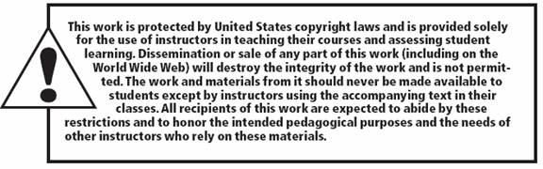
All rights reserved. No part of this publication may be reproduced, stored in a retrieval system, or transmitted, in any form or by any means, electronic, mechanical, photocopying, recording, or otherwise, without the prior written permission of the publisher. Printed in the United States of America.
Copyright © 2015 Pearson Education, Inc.

